Slide 1
Actor Model
Roger Johansson
Proto.Actor and Akka.NET Founder Twitter: @rogeralsing
Github: rogeralsing
Mail: roger@asynkron.se

Slide 2
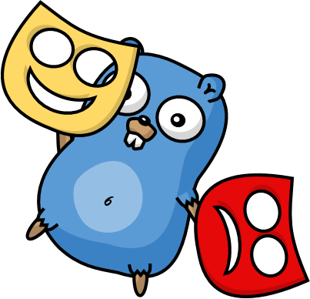
Actors
A programming paradigm

Slide 3
Actor Model
Three axioms:
Send – an actor can send messages to other actors
Spawn – an actor can spawn new actors
Become – an actor can decide how to handle it’s next message

Slide 4
Actor Model
”An island of consistency in a sea of concurrency”
”Shared nothing”, ”Black box”
”Location transparent”, ”Distributable by design”

Slide 5
Actor Model
BEAM – Erlang, Elixir, LFE
JVM – Akka, Orbit
.NET – Akka.NET, Proto.Actor, Project Orleans
Go – Proto.Actor

Slide 6
Proto.Actor
Next Generation Actor Model:
Built on standards – Protobuf, gRPC Streams, Consul/Kubernetes
Platform independent – C#, Go, Kotlin
Actors and Virtual Actors – Unified model of Akka and Project Orleans
Ultra fast – 65 times faster than Akka.NET over network

Slide 7
OOP vs. Actor Model
OOP
Actor Model
Behavior
Behavior
Stateful
Stateful
Synchronous method calls
Asynchronous message passing
Why Actors?? The synchronous model has worked nicely for 60 years!?

Slide 8
Moore’s Law
We can no longer build faster processors Instead, we stack them next to eachother and call them ”cores”

Slide 9
Why do we as developers have to care?

Slide 10
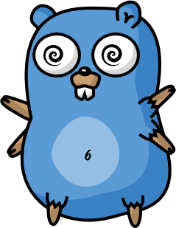
Scaling Up

Slide 11
How do you scale up in .net ?
Using Theads
Thread Pool
TPL – Tasks, Data Flow
Channels
Parallell Linq

Slide 12
What happens when you cannot
scale up any more?

Slide 13
Scaling Out

Slide 14
How do you scale out in .net ?
Services, HTTP or gRPC
Queues and logs, Rabbit MQ or Kafka

Slide 15
We have different tools for scaling up and out.
An HTTP API has very little in common with Threads.
You have to make decisions upfront on how to design your system

Slide 16
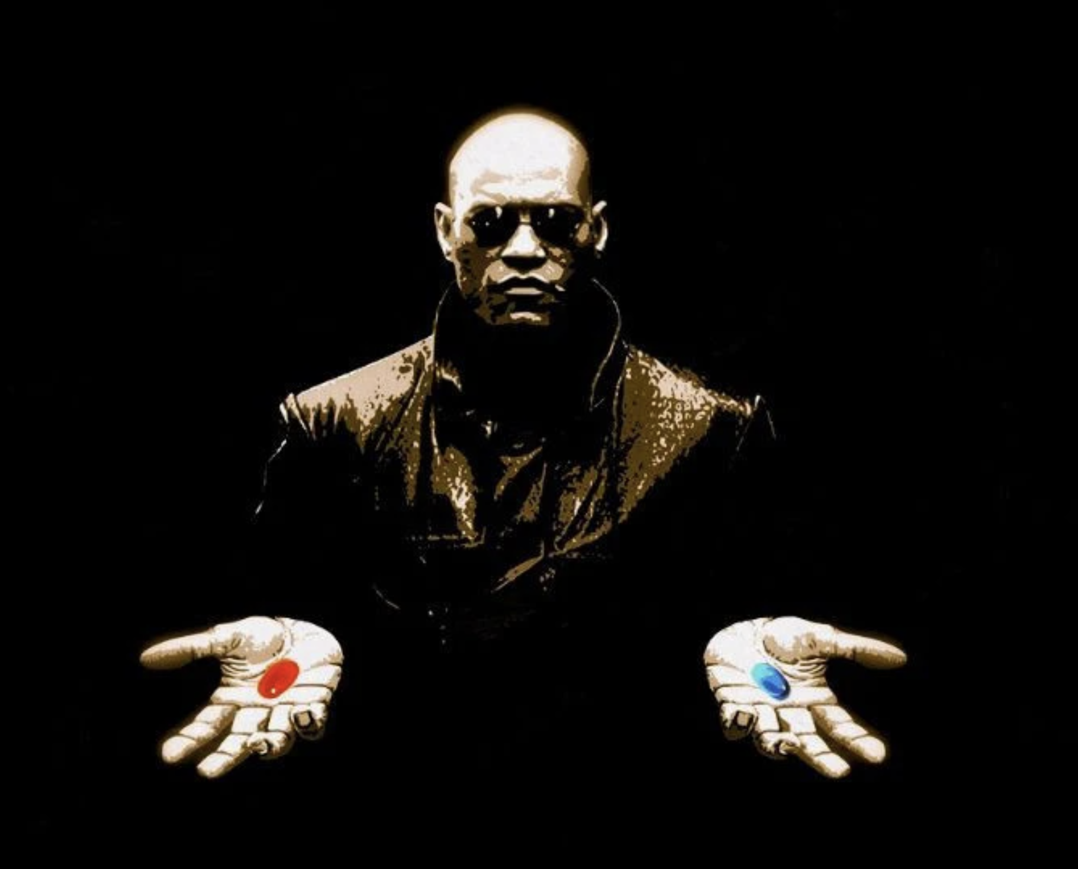
What if I told you…

Slide 17
Scale up and out, are essentially the same
That is; We want to execute code ”somewhere”, on a core, on a machine, in a cluster.
Why should we as developers have to resort to different technologies to do the same thing?

Slide 18
Event-driven thread
Actor
Mailbox
Transport
PID
Behavior
State
Supervision
Children

Slide 19
Hello World Demo

Slide 20
Chat Demo

Slide 21
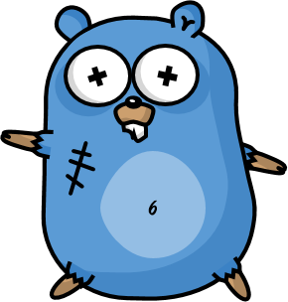
Design for failure
The famous Erlang 99.9999999% uptime

Slide 22
Website
Businesslogic
Data Access

Slide 23
Service Technician
Out of beans
Refill beans
Insert coins
Me
Vendor machine
Need more coins
Out of beans!
Gets coffee

Slide 24
Supervisor
Application error
Manage failures
Request
Client
Service
Validation error
Response

Slide 25
Error Kernel
/
99.9999999% uptime ~0.03 sekunder downtime per år
OneForOne supervisor
/a1
/a2
AllForOne supervisor
/b1
/b1
/b2
/b3
/b3
/c1
/c2
/c3
/c4
/c5

Slide 26
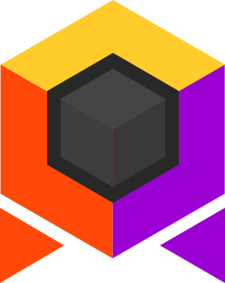
Virtual Actors
Always Exists, Never Fails

Slide 27
Virtual Actors
Virtual actors are:
Virtually always existing
Addressed via ”Identity” and ”Kind”
Request Response driven
Built ontop of plain actors

Slide 28
Virtual Actors
Kind:”asset” think class in OOP
Identity + Kind ➔ PID = Virtual Actor
Identity: ”SomeAsset123” think object reference in OOP
PID: SomeAsset123/asset/$1@somehost:8080 think object instance in OOP

Slide 29
Virtual Actors
SomeAsset124 + asset
SomeAsset123 + asset

Slide 30
Virtual Actors

Slide 31

Realtime Map
Asset Actor
User Viewport
MQTT
Realtime Map

Slide 32
Companies using Proto.Actor
Huawei Research
Oracle – FnProject
FirstGenesis – Virtual Actor Blockchain patent

Slide 33
There are a lot more concepts
Routers
Persistence
Behaviors
Middleware

Slide 34
The End
Roger Johansson
Twitter: @rogeralsing
Github: rogeralsing
Mail: roger@asynkron.se
http://Proto.Actor

